Slide 1

Evolved a Robocode tank using genetic programming
張筠婕 戴宗明 連俊豪

Slide 2
Outline
Introduction
Architecture
Encode / Decode
Crossover
Mutation
Fitness
Selection
How we apply GP to Robocode
What we have done
Future works
Q&A?

Slide 3
Background introduction

Slide 4
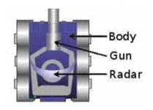
Introduction
1. Tank can move forward and backward
2. There are three components
Radar: Scan the enemy
Gun: Fire bullets
Body: Moving direction
3. Once the energy is empty, any additional damage will destroy the tank
4. You can ram or fire to cause damage

Slide 5
Introduction
5. There are some “benchmark” built-in robots
Spin-Robot: Circle movement, shoot when heading target (no radar lock)
Trackfire: Scan for target, then fire till dead (radar lock target, no movement)
Ramfire: Ram target, then ramp + fire till dead
Crazy: Randomly move (not really), fire when scanned target

Slide 6
Introduction
5. Result scores
Total Score - This is everything else added up, and determines each robot's rank in this battle.
Survival Score - Each robot that's still alive scores 50 points every time another robot dies. Last Survivor Bonus - The last robot alive scores 10 additional points for each robot that died before it.
Bullet Damage - Robots score 1 point for each point of damage they do to enemies.
Bullet Damage Bonus - additional 20% of all the damage it did to that enemy when killed enemy.
Ram Damage - Robots score 2 points for each point of damage they cause by ramming enemies. Ram Damage Bonus - additional 30% of all the damage it did to enemy when killed enemy.
6. Ram is continuing push target when hitting it
7. If continuing push wall when hitting, it will suffer damage

Slide 7
Genetic Programming

Slide 8
Architecture

Slide 9
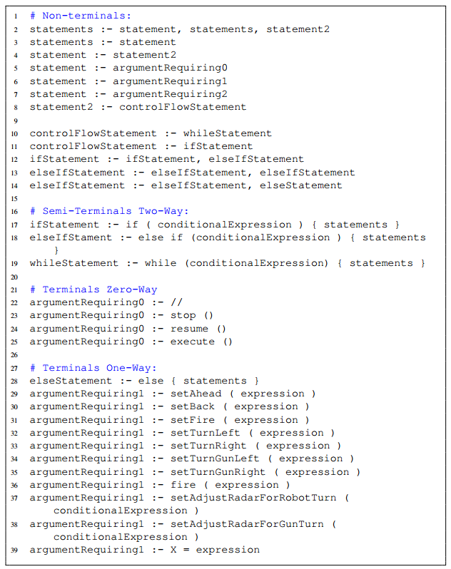
Encode
1. A chromosome contains multiple trees
2. Trees are ruled by a syntax table

Slide 10
Decode

Slide 11
Decode
0
1
1
1
1
1
1

Slide 12
Decode
1. Prefix traversal if mark is “1”
IfStatement
ConditionExp
Statement
ElseIfStatement
ConditionExp
Statement
2. Expand the code
If ( ConditionExp ) {
Statement
}
Else if ( ConditionExp ) {
Statement
}
0
1
1
1
1
1
1

Slide 13
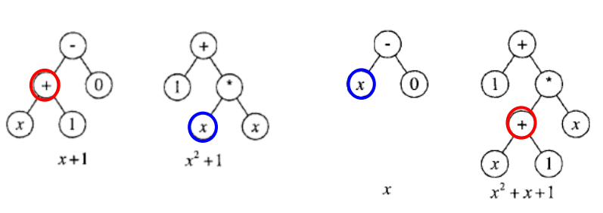
Crossover
Swap two sub-tree
Only swap those who has the same type of rules

Slide 14
Mutation
Re-generate a sub-tree by randomly choose a node

Slide 15
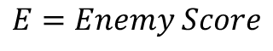

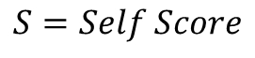
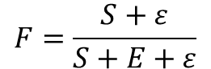


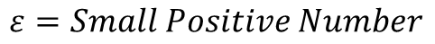
Fitness
Encode the population into three groups
Decode the tree into source code
Compile the source code by control engine
Simulation
Score the result by formula bellow
$$S_{1}=0.2 × Ram+0.4 ×Bullet+0.4×Survive$$
$$F=\frac{S+ε}{S+E+ε}$$
$$S_{2}=0.4 × Ram+0.2 ×Bullet+0.4×Survive$$
$$S=Self Score$$
$$S_{3}=0.2 × Ram+0.2 ×Bullet+0.8×Survive$$
$$E=Enemy Score$$
$$ε=Small Positive Number$$

Slide 16
Fitness
In each generation, we will use average the score(S) of competition with spin-robot, trackfire, ramfire, crazy and the top robot of each population group from the last generation

Slide 17
Selection
The top 10% parents copy directly into next generation
Fill the population of next generation with others (parents and offsprings)

Slide 18
Robocode intrgration

Slide 19
How we apply GP to robocode
We hand-made a robot first !!

Slide 20
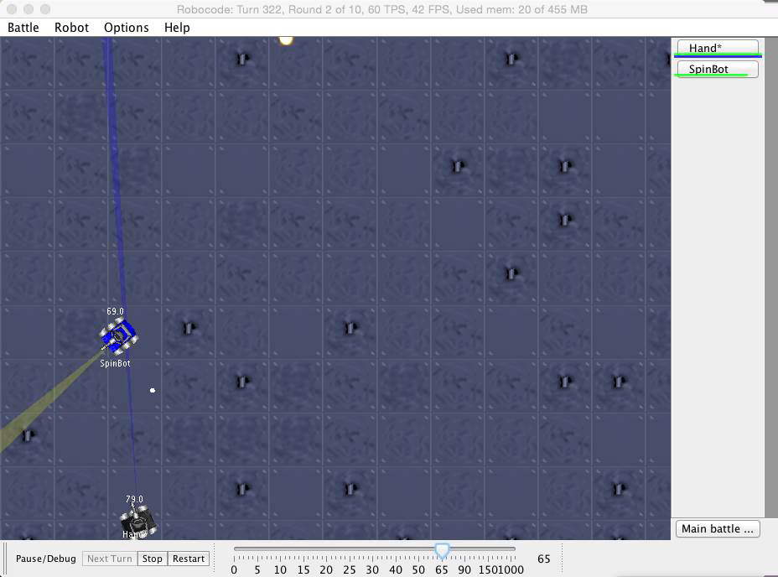

Slide 21
How we apply GP to robocode
We hand-made a robot first !!
It’s already been a good robot ( can win all the built-in robots )
But we want to improve it’s movement, there are also some features we want to reserved by hardcode (radar-lock, track-gun…)
Therefore, we intend to put THREE GP-trees into
OnHitWall() – Reaction when robot hit wall
doMove() – Movement, can also escape or ram enemy
doFire() – Accuracy !!!
Finally, IF AND ONLY IF WE EVOLVE THE ROBOT WELL (coding and benchmark), We will insert a local search to tune the parameters !!

Slide 22
What we have done
The parser
The control engine

Slide 23
Future works
(Sunday is a good ending of a week, also a good start :P)
Now ~ 5/10 GP
5/10 ~ 5/17 Test
5/17 ~ 5/24 Evolve
5/24 ~ Final Tune and fix

Slide 24
Q&A?

